Slide 1

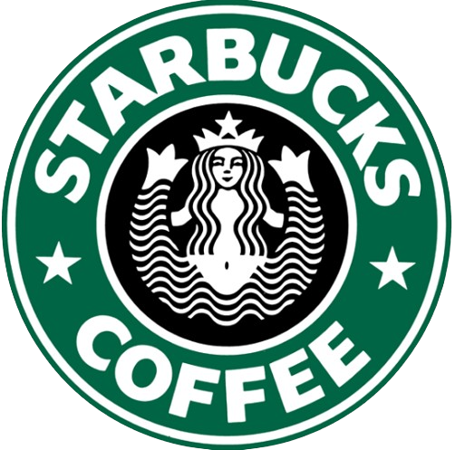
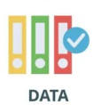







CASE STUDY ANALYSIS
Seattle, Washington
A transnational American chain of coffee shops and Roasteries.
Expanded over 25,000 stores worldwide
Ameya Team
Chemuru Lasya

Slide 2


Introduction
This case study analyzes Starbucks' customer data, focusing on demographics and transactional behaviors. Customers received various promotional offers, and our goal was to understand how they responded to them and Segment them based on their transactional behavior. Based on the results, we aim to develop more effective strategies for targeted promotions and enhancing customer loyalty.

Slide 3


Understanding the Data
Starbucks provided a variety of promotional offers to 17,000 customers, differing in type, duration, reward, and difficulty. These offers were delivered through multiple channels, including social media, email, mobile apps, and websites.
The dataset includes customer details such as age, gender, income, and membership start date.
It also records customer interactions and transactions, categorized into three offer-related events: offer received, offer viewed, and offer completed. Additionally, a 'Transaction' event is recorded when a customer makes a purchase.
Each event's timing is documented in hours, with the first offer sent at hour zero.

Slide 4

Methodology
DATA CLEANING
DATA TRANSFORMATION
DATA ANALYSIS
CUSTOMER SEGMENTATION

Slide 5

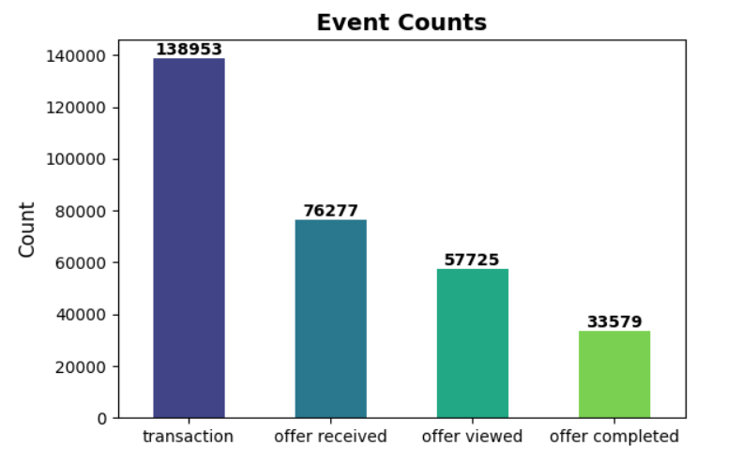
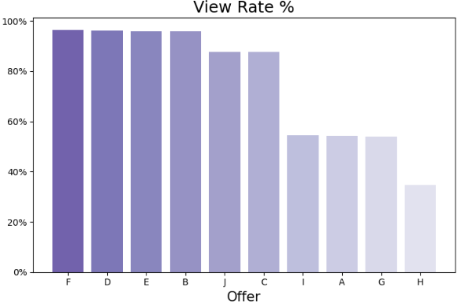
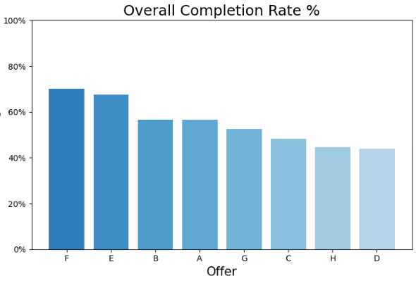
Analysis Results
The dataset contains transactions, more than four times the number of completed offers.
Throughout the campaign, out of offers total offers received by customers received 76% were viewed.
The campaign saw 33,579 offers completed, representing 58% of viewed offers and 44% of all offers distributed.
In the view rate plot we can clearly observe that there are 4 different levels in height, separating the offers into four groups.
Group-wise View Rates:
Highest (96%): Group 1 (Offers F, D, E, B)
→ Used email, mobile, social media, web.
High (90%): Group 2 (Offers J, C)
→ Used email, mobile, social media.
Moderate (55%): Group 3 (Offers I, A, G)
→ Used email, mobile, web.
Lowest (36%): Group 4 (Offer H)
→ Used email, web.
Social Media > Email ≈ Mobile > Websites.
The most successful offers were Offer F, Offer E, and Offer B, which saw overall completion rates of 70%, 68%, and 56%, respectively.
Offer D had the lowest performance, with a completion rate of approximately 44%.
It is evident that the offers with the highest completion rates, F and E, are discount offers.

Slide 6
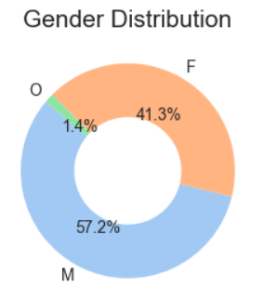
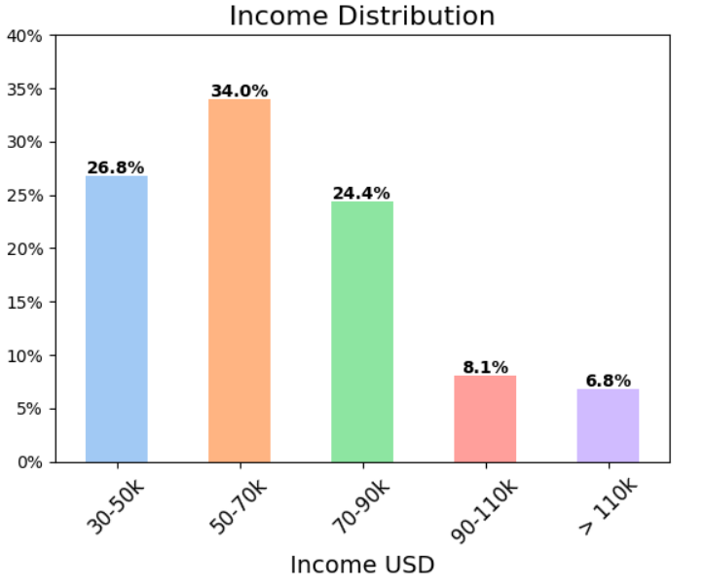
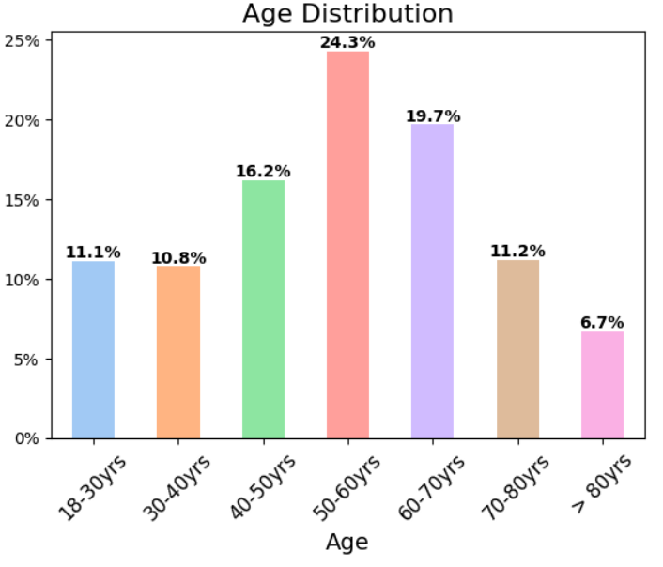
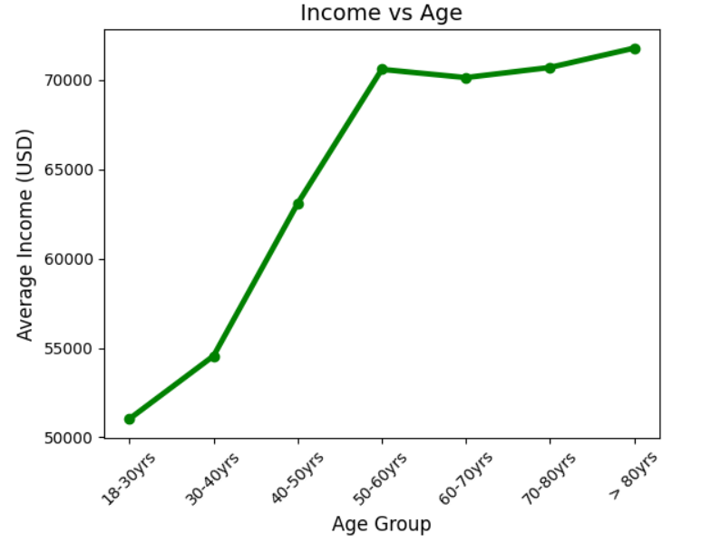
Analysis Results
A significant portion of the customers earn an income range between $50,000 and $70,000 followed by those earning $30,000 to $50,000 and $70,000 to $90,000
There are more males(57.2 %) compared to females(41.3 %) and a small percentage of other gender(1.4 %)
The largest customer age group is 50-60 years (24.3%), followed by 60-70 years (19.7%), and 40-50 years (16.2%).
These top three age groups collectively account for 60.2% of the total customer base.
The graph shows a clear trend where average income increases with age, peaking in the 50-60 years age group.

Slide 7
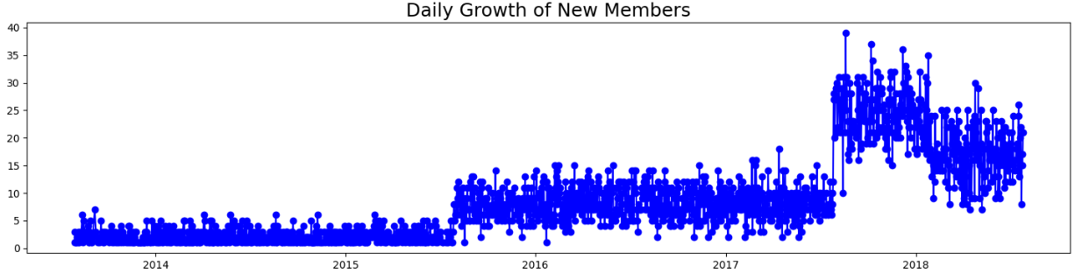
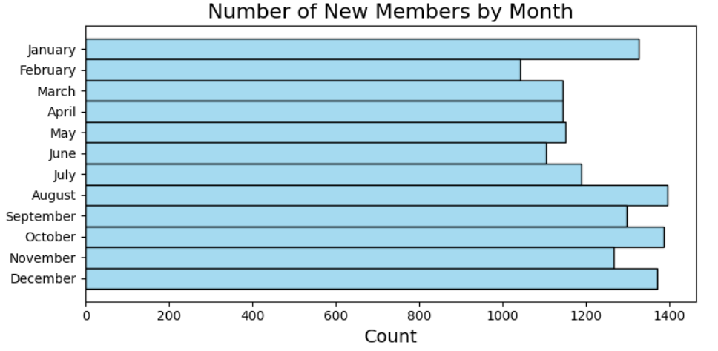
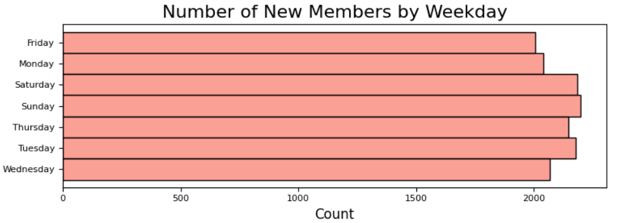
Analysis Results
The graph shows a clear upward trend in member registrations over the years from 2013 to 2017, with 2017 having the highest number of registrations. This suggests that Starbucks’ membership program gained increasing popularity during this period.

Slide 8

Customer Segmentation
Segment | Frequency | Offer Completion rate | Offer Sensitivity | Avg Purchase value
Most valuables | High | High | High | High
High Potentials | Medium | High | High | High
Occasional Spenders | Low | Low | Medium | Medium
Regulars | High | Medium | Low | Low
Low Engagers | Low | Low | Low | Medium
Customers are classified into segments, based on their transaction behavior.
Used K Means of Clustering for Segmentation
This segmentation is cross-checked using Logistic Regression (99.55 %) and KNN Classification (97.39%)

Slide 9
Customer Distribution
Customer Demographics
Cluster | Avg_Age | Avg_Income
High-Potentials | 57.58 | $73,818.76
Low-Engagers | 52.60 | $60,911.31
Most-Valuables | 56.30 | $71,676.52
Occasional-Spenders | 54.53 | $63,550.91
Regulars | 47.46 | $48,837.01

Slide 10

Strategies to be implemented
Offer Related Strategies
Multi Channel Promotion
-especially social media and email
Prioritize Discount Offers
Simplify and Extend Offers
Customer Segment Targeting
Increase Engagement in High Potentials
- Tailor campaigns to this segment by promoting
premium offerings and loyalty programs that
reward frequent visits
Re-engage “Low-Engagers” and “Occasional Spenders”
- Develop personalized offers aligning with
their price sensitivity and preferences
Loyalty and Upselling
- Enhance the "Most-Valuables" Experience by
introducing exclusive benefits
Upsell to "Regulars“
- offering bundled deals or premium options at a
discounted rate occasionally.
Demographic Targeting
Launch targeted marketing campaigns on female customers and other genders.
Introduce Couple Offers and Themed Promotions
- Like Buy one get one offer for
couples on February month

Slide 11

THANK
YOU!!

Slide 12

Links to my Data sets and Jupyter Notebook :
Data Sets:
Profile Data
https://github.com/ChemuruLasya/Data-Files/blob/main/Starbucks%20Case%20Study%20Files/Starbucks_profile.xlsx
Portfolio Data
https://github.com/ChemuruLasya/Data-Files/blob/main/Starbucks%20Case%20Study%20Files/Starbucks_portfolio.xlsx
Transactions and Events Details
https://github.com/ChemuruLasya/Data-Files/blob/main/Starbucks%20Case%20Study%20Files/Starbucks_transcript.xlsx
Python Notebook
https://github.com/ChemuruLasya/Analysis-Results/blob/main/Starbucks%20Case%20Study%20Analysis/CaseStudy_Analysis.ipynb

